Slide 1
Formal Privacy: Making an Impact at Large Organizations Deploying Differential Privacy for the 2020 Census of Population and Housing
Simson L. Garfinkel Senior Scientist, Confidentiality and Data Access U.S. Census Bureau July 31, 2019
JSM 2019
The views in this presentation are those of the author, and not those of the U.S. Census Bureau.

Slide 2
The views in this presentation are those of the author, and not those of the U.S. Census Bureau.

Slide 3
Acknowledgments
This presentation incorporates work by:
Dan Kifer (Scientific Lead)
John Abowd (Chief Scientist)
Tammy Adams, Robert Ashmead, Aref Dajani, Jason Devine, Nathan Goldschlag, Michael Hay, Cynthia Hollingsworth, Meriton Ibrahimi, Michael Ikeda, Philip Leclerc, Ashwin Machanavajjhala, Christian Martindale, Gerome Miklau, Brett Moran, Ned Porter, Anne Ross, William Sexton, Lars Vilhuber, and Pavel Zhuravlev

Slide 4
Key points about the 2020 Census
“Count everyone once, only once, and in the right place.”
World’s longest-running statistical program.
First conducted in 1790 by Thomas Jefferson
Must be an “actual Enumeration” (US Constitution)
Data collected under a pledge of confidentiality

Slide 5
Disclosure Avoidance in the 2010 Census: Swapping
2010 Census used household swapping
Swapping was limited to households within a state
Swapping was limited to households the same size
Swapping rate is confidential.
We performed a reconstruction attack and re-identified data from 17% of the US population.
We did not reconstruct families.
We did not recover detailed self-identified race codes

Slide 6
Disclosure Avoidance and the 2020 Census: Differential Privacy
USCB first adopt differential privacy in 2008 for OnTheMap
John Abowd became Chief Scientist in 2016 with the goal of modernizing disclosure avoidance
Data products include:
Decennial Census of Population and Housing
Economic Census
American Community Survey
Ad hoc research in Federal Statistical Research Data Centers
+100 other major data products

Slide 7
Despite its Size, the Decennial Census is the Easiest US Census Bureau Product to Make Differentially Private
Only 5 tabulation variables collected per person:
Age, Sex, Race, Ethnicity, Relationship to Householder, Location
It’s a census — no weights!
National Priority ➔ well-funded

Slide 8
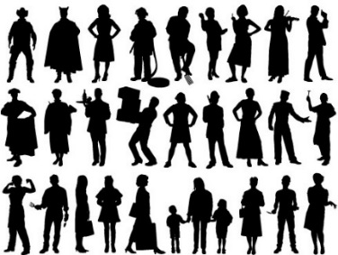

DAS allows the Census Bureau to enforce global confidentiality protections
Pre-specified tabular summaries: PL94-171, DHC, DDHC, AIANNH
Decennial Response File
Census Unedited File
Census Edited File
Global Confidentiality Protection Process
Disclosure Avoidance System
Microdata Detail File
NOISE BARRIER
Special tabulations and post-census research
Privacy-loss Budget,
Accuracy Decisions
Notes:
In the 2020 Census of Publishing and Housing,
SF1 is replaced by Demographic and Household Characteristics
SF2 is replaced by Detailed Demographic and Household Characteristics
AIANNH is American Indian, Alaska Native and Native Hawaiian
DDHC and AIANNH will be generated directly from the DAS and not pass through the MDF, nor will the join tables once they have been named

Slide 9
The Disclosure Avoidance System relies on injects of formally private noise
Advantages of noise injection with formal privacy:
Transparency: the details can be explained to the public
Tunable privacy guarantees
Privacy guarantees do not depend on external data
Protects against accurate database reconstruction
Protects every member of the population
Challenges:
Entire country must be processed at once for best accuracy
Every use of confidential data must be tallied in the privacy-loss budget
Global Confidentiality Protection Process
Disclosure Avoidance System
ε

Slide 10
There was no off-the-shelf system for applying differential privacy to a national census
We had to create a new system that:
Produced higher-quality statistics at more densely populated geographies
Produced consistent tables
We created new differential privacy algorithms and processing systems that:
Produce highly accurate statistics for large populations (e.g. states, counties)
Create protected microdata that can be used for any tabulation without additional privacy loss
Fit into the decennial census production system

Slide 11
Basic approach for a DP Census
Treat the entire census as a set of queries on histograms.
Select the specific queries to measure
Six geolevels (nation, state, county, tract, block group, block)
Thousands of queries per geounit
Billions of queries overall
Histogram has billions of cells

Slide 12
First effort: The block-by-block algorithm Independently protect each block (parallel composition)
8 million blocks
Disclosure Avoidance System
8 million protected blocks
NOISE BARRIER
Measure queries for each block; privatize queries; convert results back to microdata

Slide 13
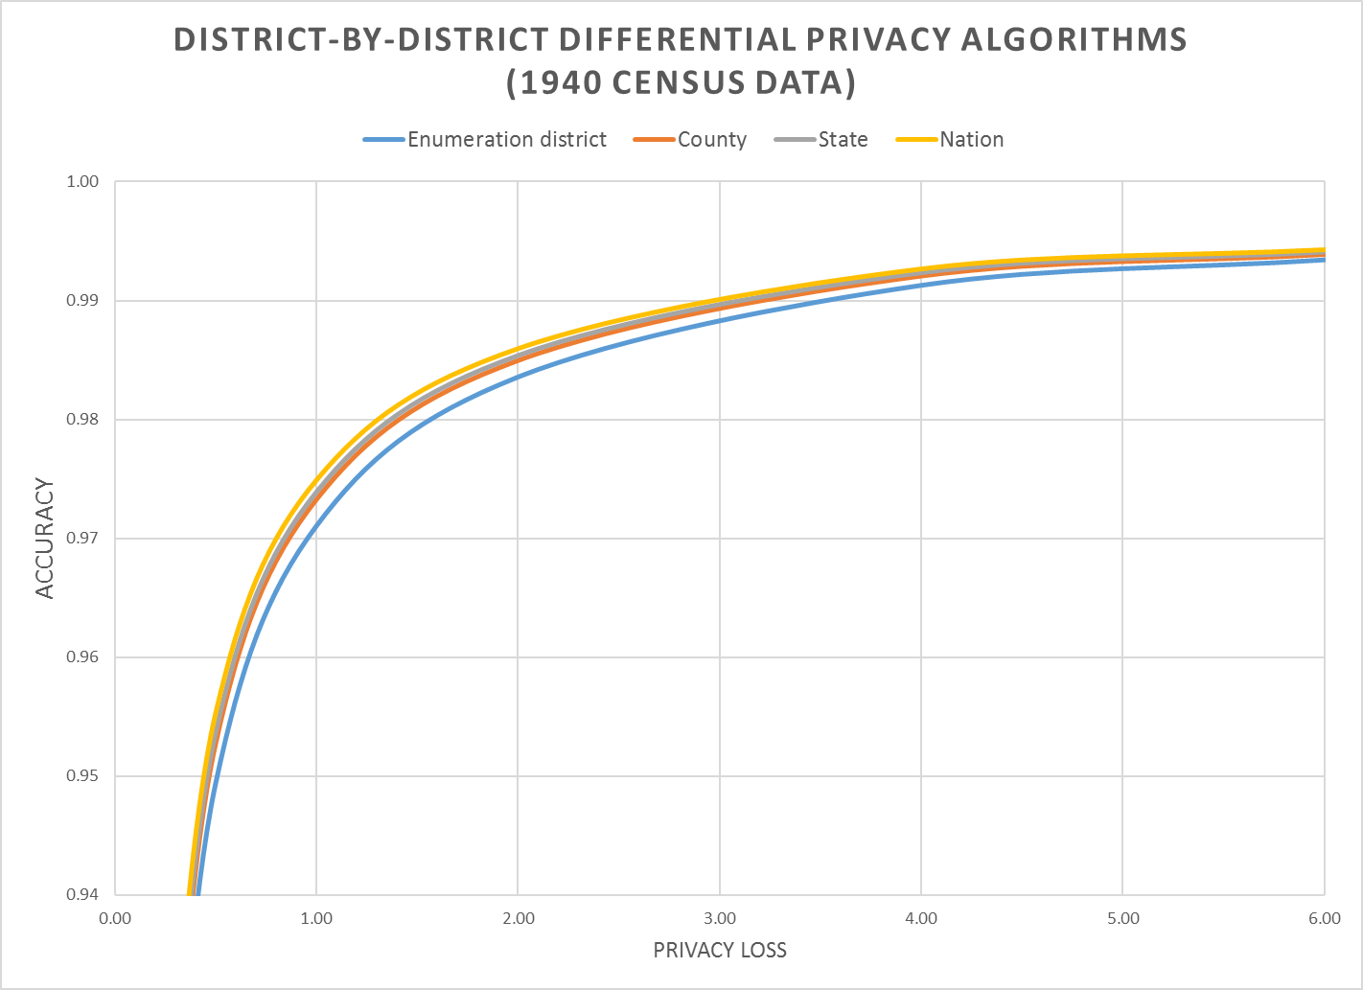
Tested with data from 1940
1940 hierarchy:
Nation
State
County
Enumeration District
Download from usa.ipums.org
Notes:
Accuracy (in all slides) is (1 – AveTVD/N), where AveTVD = Average Total Variation Distance = Sum( 0.5L_1) over all query sets in the PL94 workload over all geographies in the workload divided by the number of query sets (14), L_1 is the absolute error in all the table, and N is the population count in the complete person table (1940 population). AveTVD is averaged over all the tables in the workload for the relevant geography.
In the 1940 Census data, the geography is nation, state, county, enumeration district (approximately, a modern block group, in 1940 a voting precinct in most areas).
This panel shows the performance of the district-by-district algorithm for at each level of geography for privacy-loss budgets from 0.25 to 6.00.
Workload in the experiments is the detailed histogram GQ/HH type (9) x voting age (2) x Hispanic (5) x Race (6) x Citizenship (5) measured sharing the global privacy loss budget across all levels of geography.

Slide 14
Block-by-block algorithm (also called bottomUp)
Mechanism:
Select, Measure, Reconstruct separately on each block
Advantages:
Simple and easy to parallelize
Privacy cost does not depend on # of blocks
Releasing DP for one block has same cost as releasing for all
Disadvantages
Significant error at higher level
Error adds up
Variance of each geounit is proportional to the number of blocks it contains

Slide 15
New algorithm: the top-down mechanism
Step 1: Generate national histogram without geographic identifiers.
Step 2: Allocate counts in histogram to each geography “top down.”
National-level measurements - ℇ_{nat}
State-level histograms - ℇ_{state}
County-level histograms - ℇ_{county}
Tract-level histograms - ℇ_{tract}
Block-group level histograms - ℇ_{blockgroup}
Block-level histograms - ℇ_{block}
ℇ= ℇ_{nat} + ℇ_{state} + ℇ_{county} + ℇ_{tract} + ℇ_{blockgroup} + ℇ_{block}

Slide 16
New algorithm: the top-down mechanism
Edited
Confidential data
Tabulated
Confidential data
330M records
1 National histogram
ε
National Histogram
52 “state” Histograms
ε
52 state histograms
3142 “county” histograms
ε
3,142 county histograms
NOISE BARRIER
75,000 tract
histograms
ε
75,000 census tract histograms
8 M block group histograms
ε
1 M block group histograms
8 M block histograms
ε
8 M block histograms

Slide 17
Post-process for non-negativity and consistency
Edited
Confidential data
Tabulated
Confidential data
330M records
1 National histogram
ε
National Histogram
52 “state” Histograms
ε
52 state histograms
3142 “county” histograms
ε
3,142 county histograms
NOISE BARRIER
75,000 tract
histograms
ε
75,000 census tract histograms
8 M block group histograms
ε
1 M block group histograms
8 M block histograms
ε
8 M block histograms

Slide 18
Top-Down Framework
Advantages:
Easy to parallelize
Each geo-unit can have its own strategy selection
We use High Dimensional Matrix Mechanism [MMHM18]
Parallel composition at each geo-level
Reduced variance for many aggregate regions
Sparsity discovery
e.g. very few 100+ aged people who combine 5 races
Once to—down decide a region has no such records in county A, no subregion will have them.

Slide 19
Evaluating the algorithm
We released runs of the top-down algorithm on data from the 1940 Census.
Epsilon values 0.25 .. 8.0
Multiple runs at each value of epsilon.
Caveats:
1940 data had 4 geography levels: Nation, State, County, Enumeration District.
2020 data has 6 levels: Nation, State, County, Tract, Block Group and Block.
1940 data has 6 races 2020 data has 63 race combinations
1940 data has no citizenship (Citizen or non-Citizen)

Slide 20
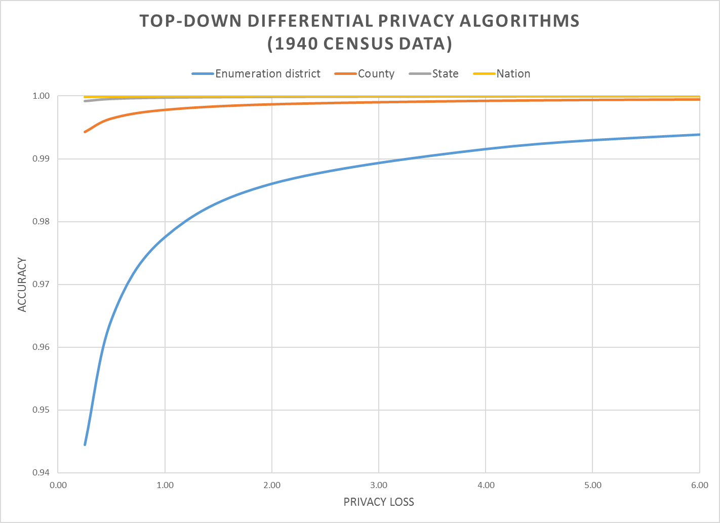
Top-Down: much more accurate!
Notes:
Accuracy (in all slides) is (1 – AveTVD/N), where AveTVD = Average Total Variation Distance = Sum( 0.5L_1) over all query sets in the PL94 workload over all geographies in the workload divided by the number of query sets (14), L_1 is the absolute error in all the table, and N is the population count in the complete person table (1940 population). AveTVD is averaged over all the tables in the workload for the relevant geography.
In the 1940 Census data, the geography is nation, state, county, enumeration district (approximately, a modern block group, in 1940 a voting precinct in most areas).
This panel shows the performance of the top-down algorithm at each level of geography for privacy-loss budgets from 0.25 to 6.00.
Workload in the experiments is the detailed histogram GQ/HH type (9) x voting age (2) x Hispanic (5) x Race (6) x Citizenship (5) measured sharing the global privacy loss budget across all levels of geography.

Slide 21
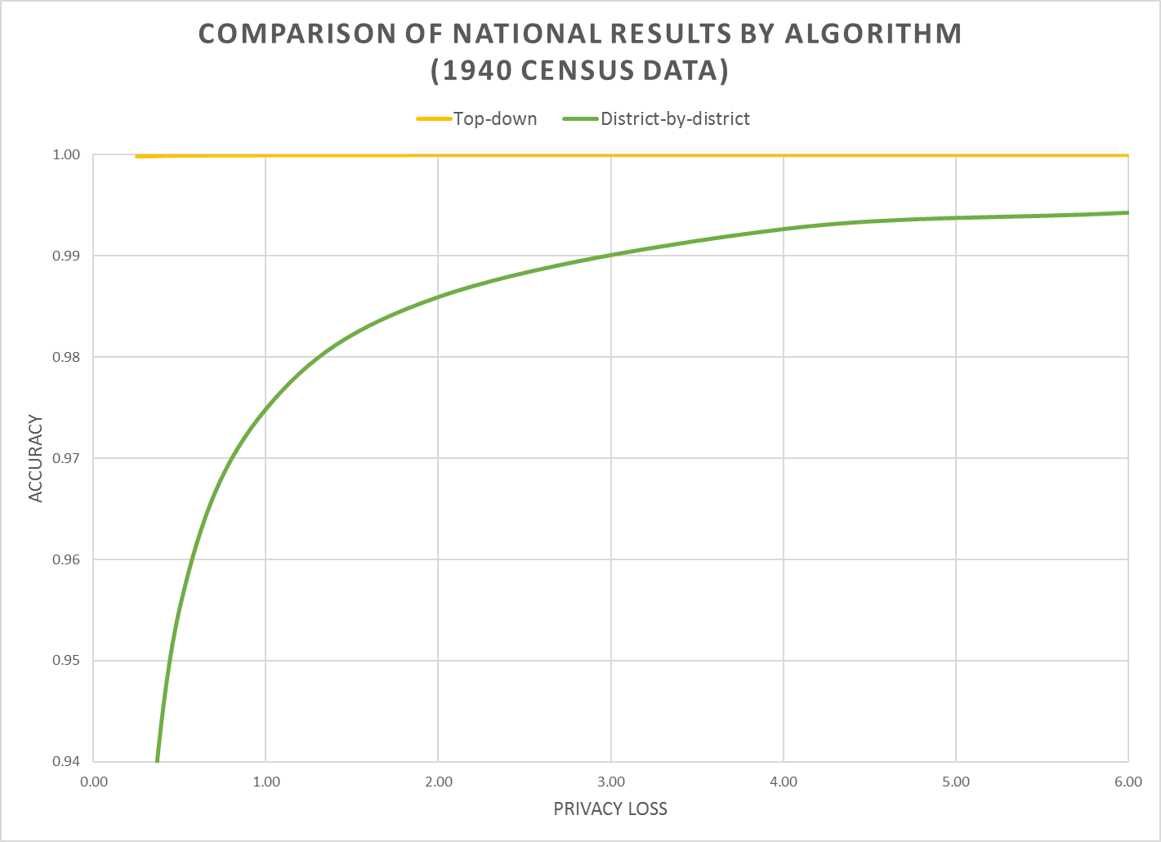
Notes:
This graph shows how the national results of the two algorithms compare..

Slide 22
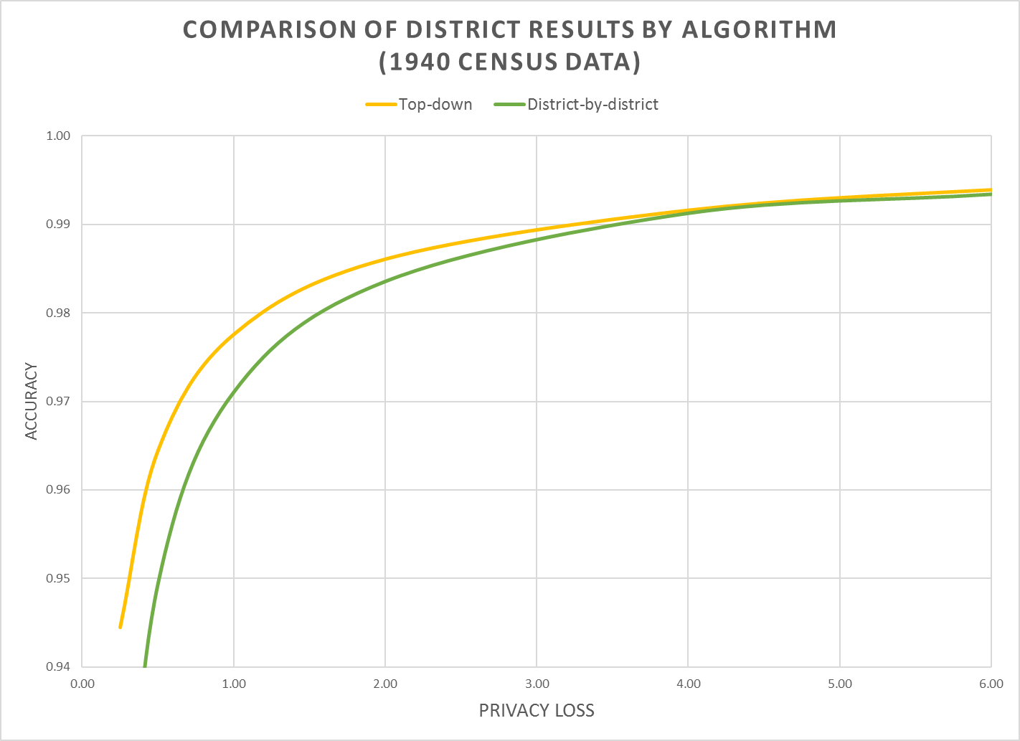
Notes:
This graph shows how the enumeration-district data for both algorithms compare.
We were surprised that the top-down algorithm is better than the district-by-district algorithm, but that makes sense, as they were gaining statistical power from the higher geographies.

Slide 23
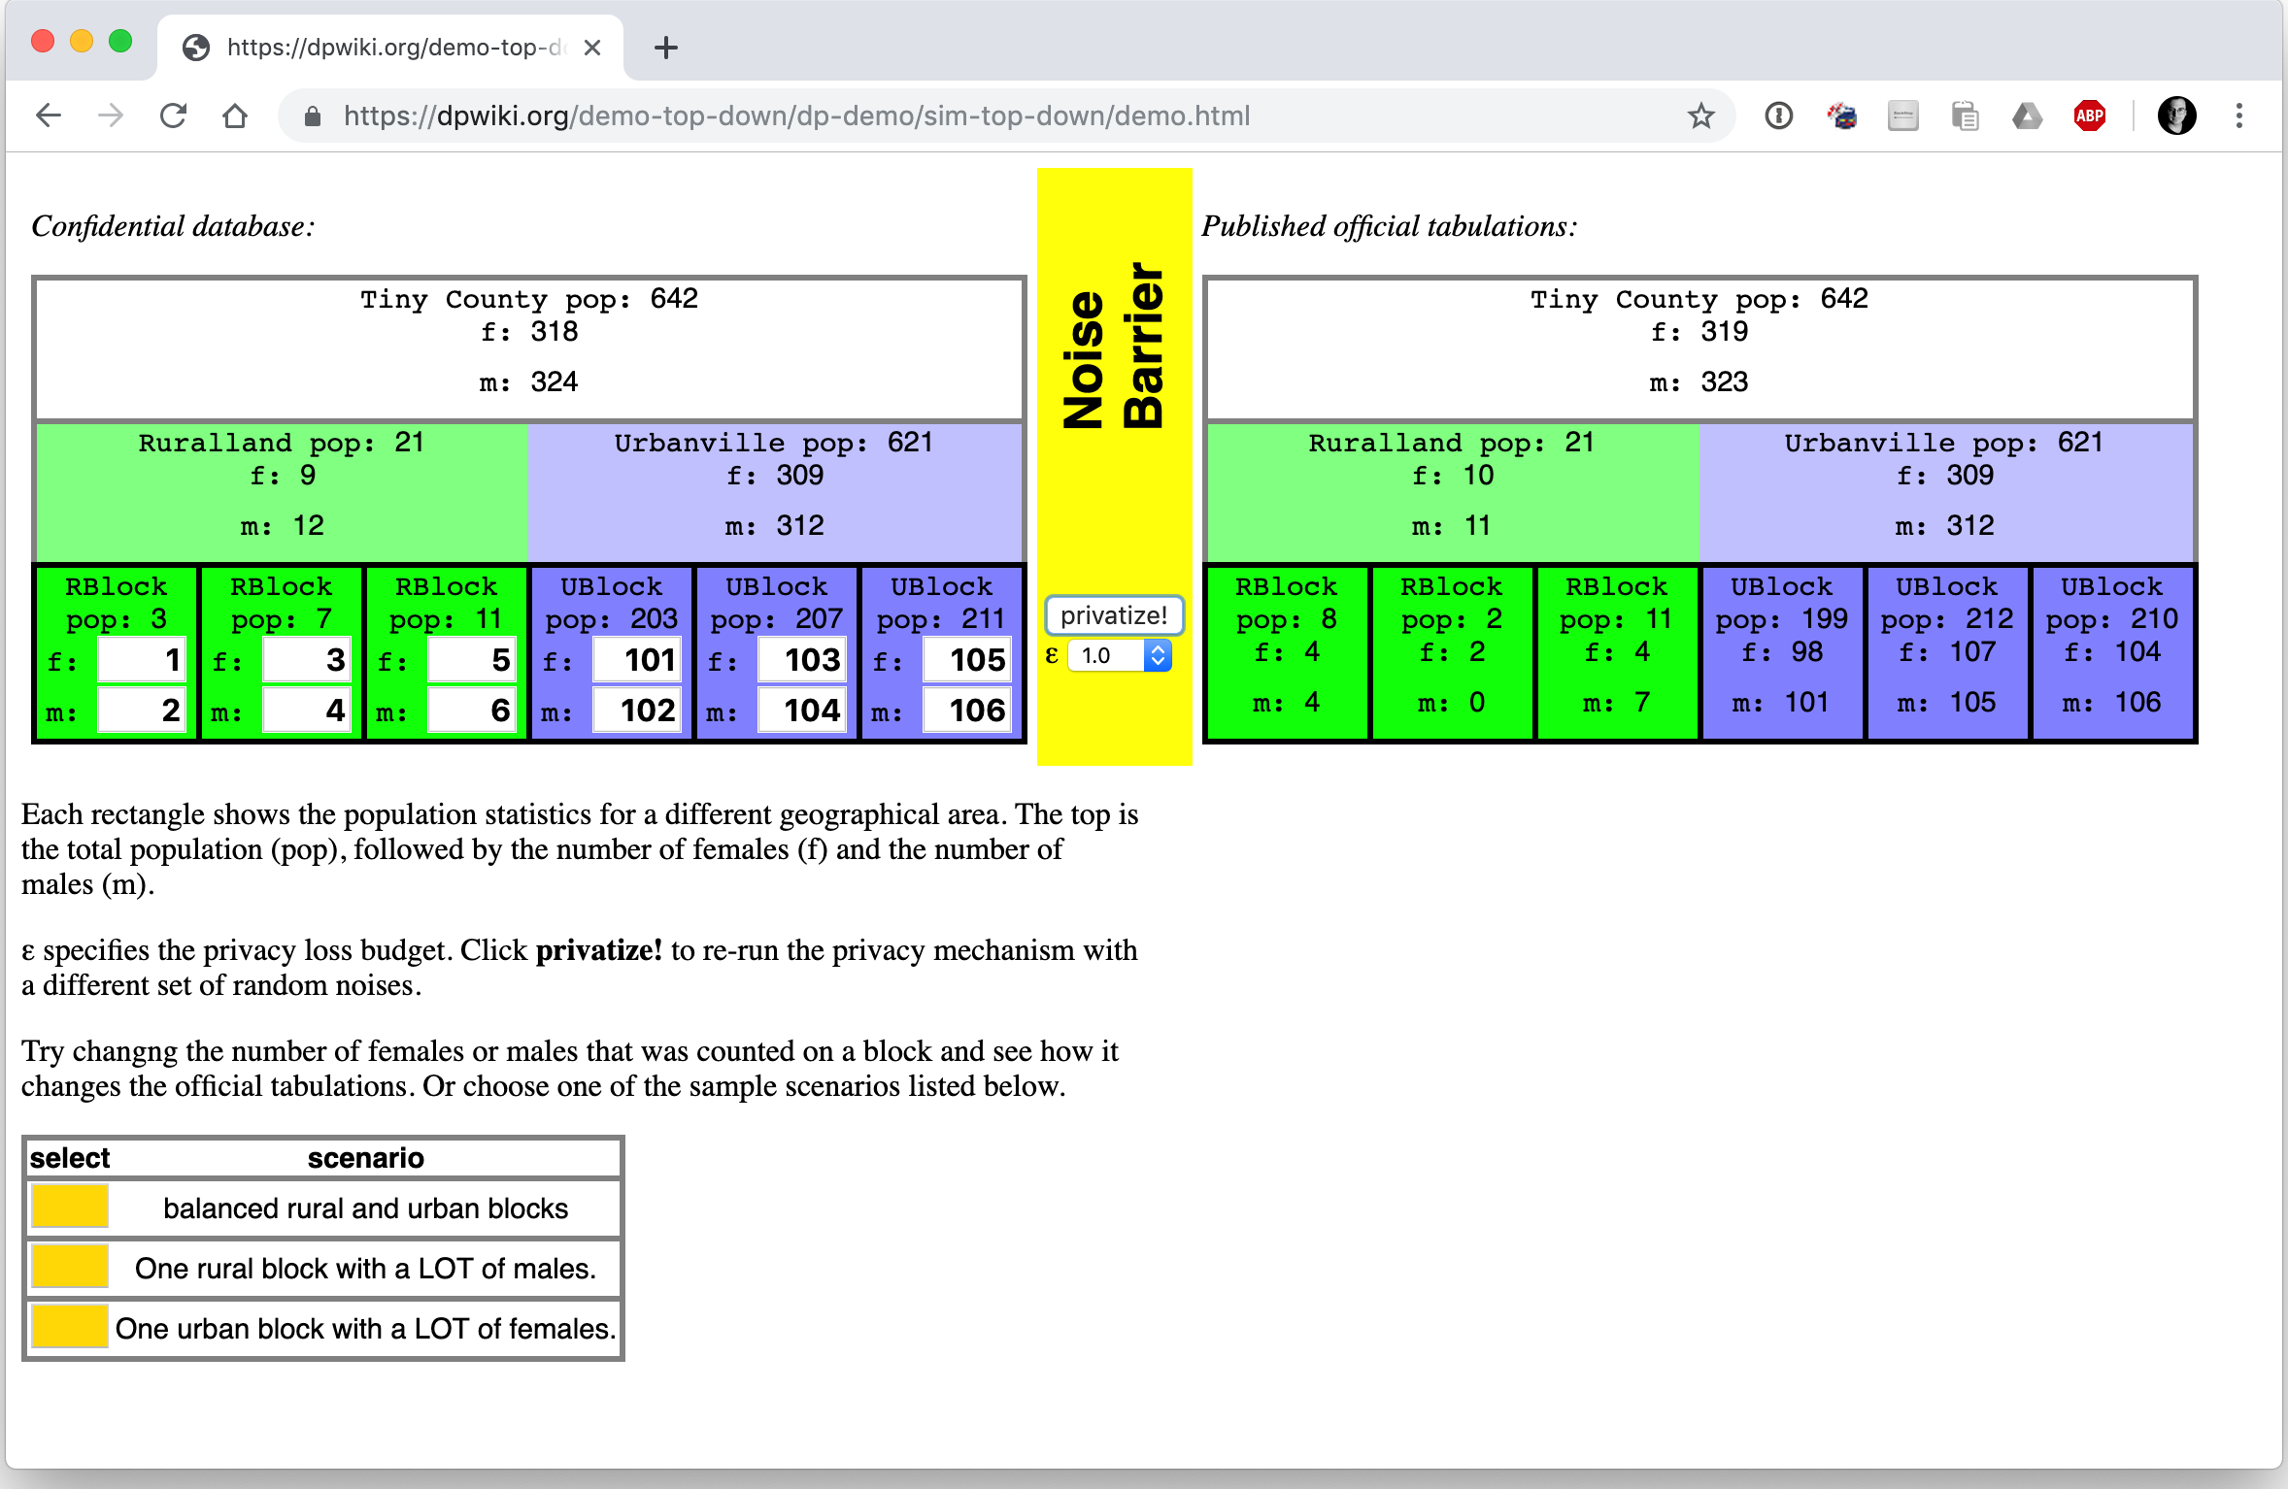
Note: The simulator uses hypothetical (fake) data provided by the user.

Slide 24
Two public policy choices:
What is the correct value of epsilon?
Where should the accuracy be allocated?

Slide 25
Organizational Challenges
Process documentation
All uses of confidential data need to be tracked and accounted.
Workload identification
All desired queries on MDF should be known in advance.
Required accuracy for various queries should be understood.
Queries outside of MDF must also be pre-specified
Correctness and Quality control
Verifying implementation correctness.
Data quality checks on tables cannot be done by looking at raw data.

Slide 26
Data User Challenges
Differential privacy is not widely known or understood.
Many data users want highly accurate data reports on small areas.
Some are anxious about the intentional addition of noise.
Some are concerned that previous studies done with swapped data might not be replicated if they used DP data.
Many data users believe they require access to Public Use Microdata.
Users in 2000 and 2010 didn’t know the error introduced by swapping and other protections applied to the tables and PUMS.

Slide 27
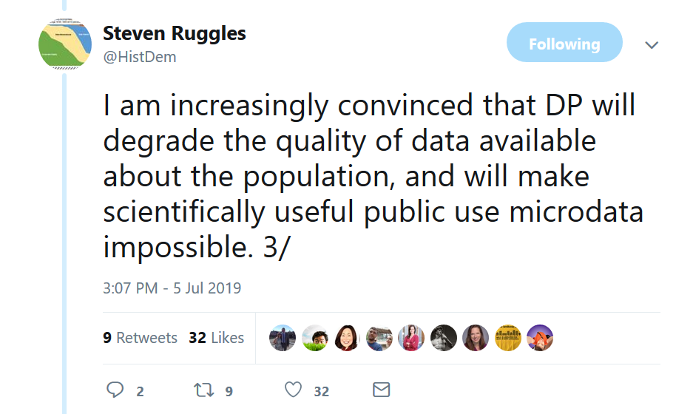
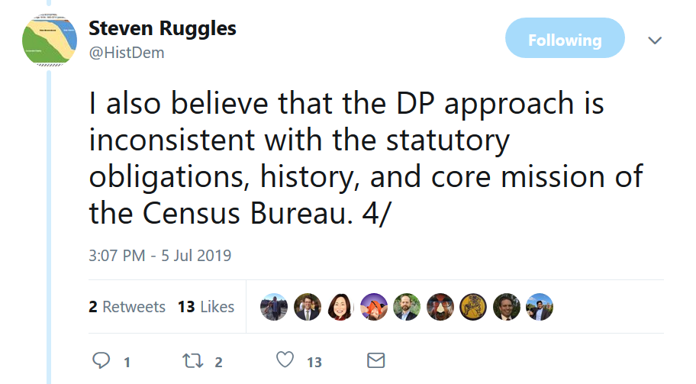
Concerns and Responses

Slide 28
Redistricting and Exact Counts
In the US, legislative districts must have equal size.
Decennial Census counts of each block are the “official counts.”
Some data users are concerned that adding noise to the counts will make them unfit for use.
However:
Evaluation of districts is based on official decennial counts; these data are used for 10 years.
Noise added by DP is significantly less than noise added by other statistical methods currently in use
Notes:
The legal evaluations are made on the ”official statistics,” no matter what those official statistics happen to be, no matter how far they may have drifted from when they were created.
One of the advantages of the top-down algorithm is that errors at the block-level cancel out at higher geographies, assuming that the higher geographies have block groups and tracts. [Abowd, all that is necessary is that the higher levels of geography be CORRELATED with block groups, tracts, counties, states.]

Slide 29

Ruggles Concerns
Differential privacy is not a measure of identifiability
Differential privacy does not measure disclosure risk
“Differential Privacy is not concerned with re-identification of respondents
“DP prohibits revealing characteristics of an individual even if the identity of that individual is effectively concealed
“This is a radical departure from established census law and precedent
“The Census Bureau has been disseminating individual-level characteristics routinely since the first microdata in 1962
Notes:
Steven Ruggles is a respected social scientist who is the director of Institute for Social Research and Data Innovation at the University of Minnesota. He is the driving force behind the IPUMS.
He has also organized a criticism of the Census Bureau’s decision to move to differential privacy.
Ruggles has repeatedly said that the law is concerned with re-identification. The Census Bureau disagrees, and says that the law is concerned with tracing data provided by an individual or an establishment back to the individual or establishment that provided it.

Slide 30
Organized attack on the move to differential privacy
Concerns:
“Differential privacy will degrade the quality of data available about the population, and will probably make scientifically useful public use microdata impossible
The differential privacy approach is inconsistent with the statutory obligations, history, and core mission of the Census Bureau”
Notes:
Ruggles is primarily concerned with the PUMS, and specifically the PUMS for the American Community Survey.
He is concerned that a synthetic PUMS will have limited use for discovering relationships that are not encoded into the PUMS when they are created. Although this is true, the high dimensionality of the decennial census, the fact that the top-down algorithm preserves a lot of spatial variance, and the fact that there is a lot of correlation between different variables means that the Decennial PUMS will probably be more useful than a naïve application of DP would imply.
There are more testable hypotheses in the proposed 2020 public use products than there were in 2010 public-use products. The query space is broader. And all the hypotheses are accompanied with correct measures of error.

Slide 31
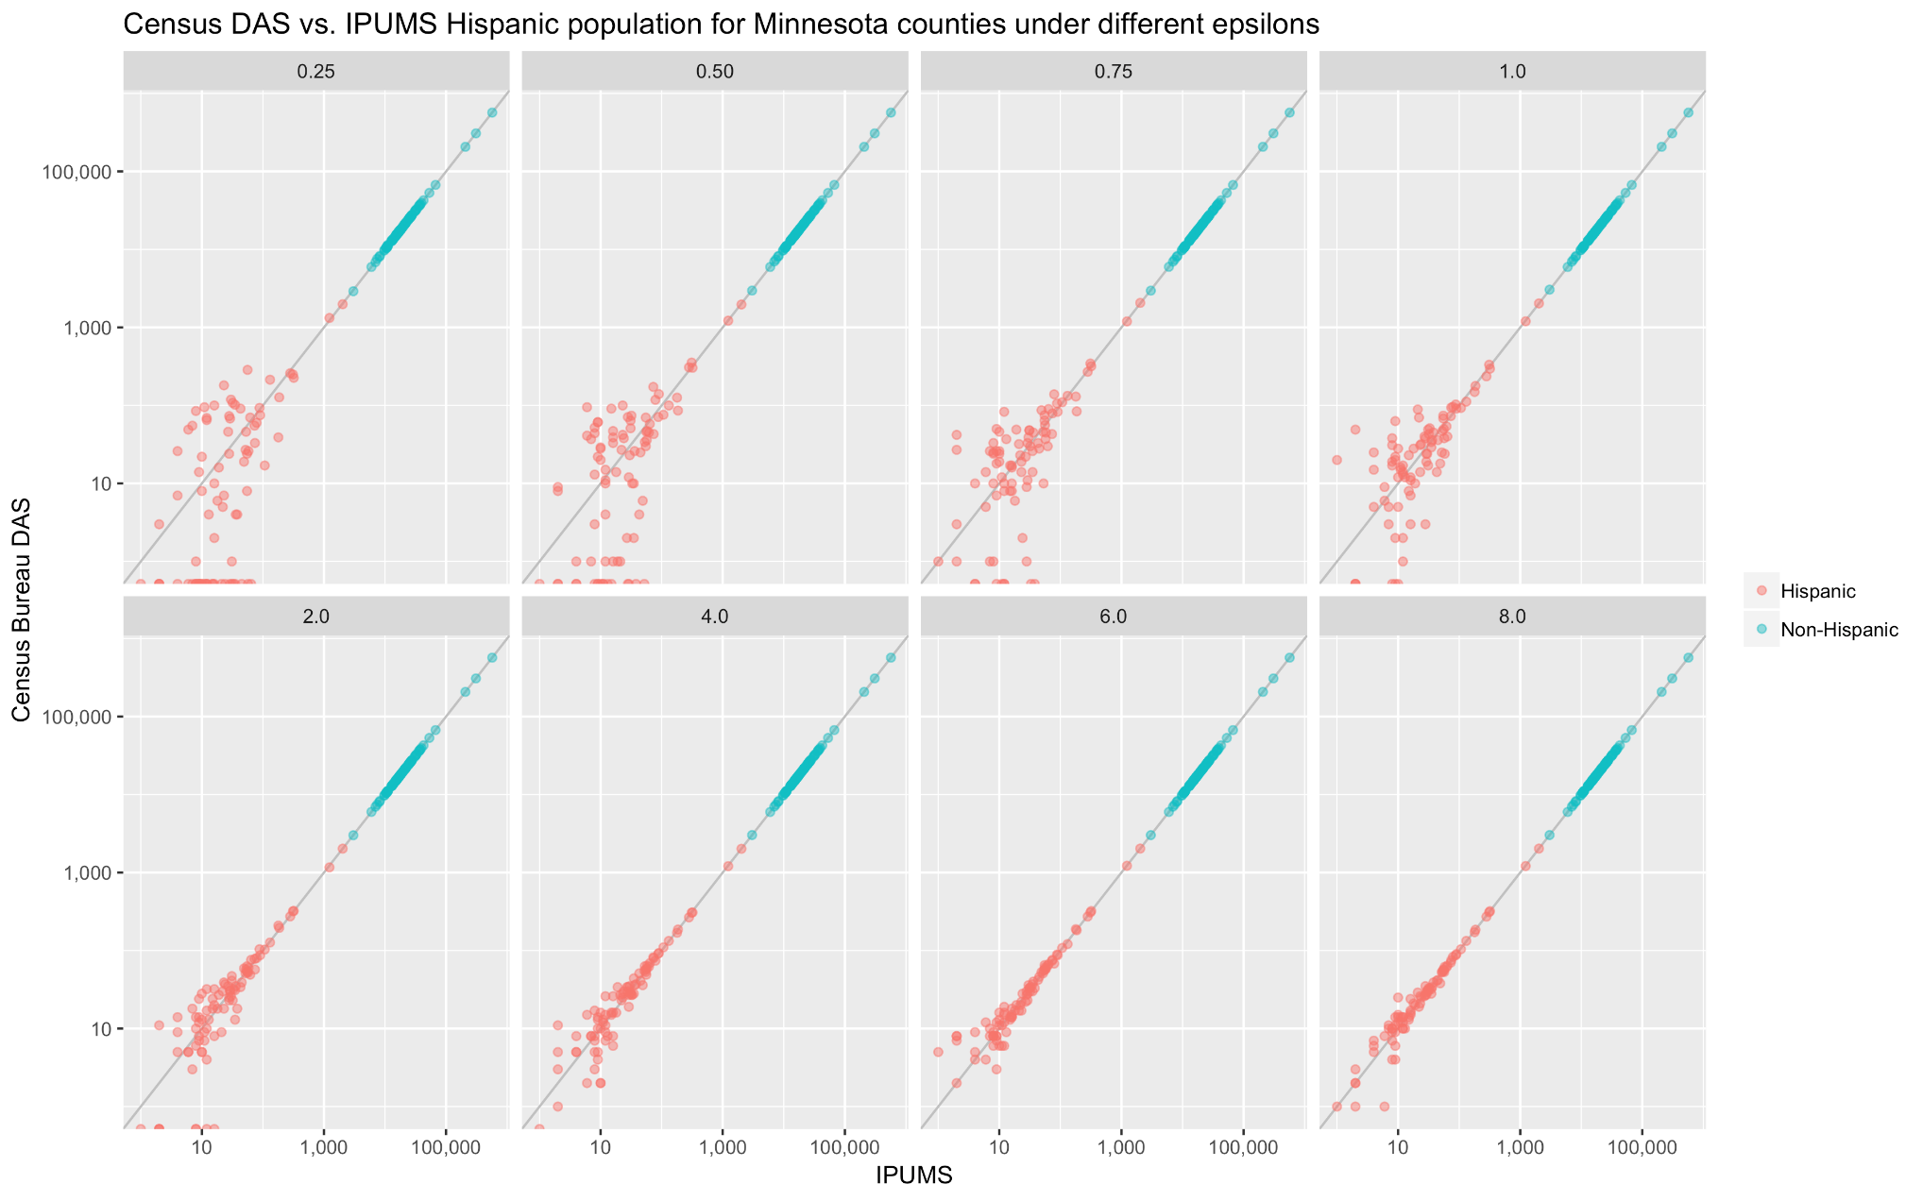
Analysis of population variances David Van Riper & Tracy Kugler, IPUMS (APDU 2019)
Notes:
This graph shows an analysis done by David Riper and Tracy Kugler which was presented at the Association of Public Data Users a few weeks ago.
These graphs show that the algorithms are doing exactly what they are designed to do: as the number of people in a geographic area increases, the statistics about that area become more precise. Sparsely populated geographic areas are inherently risky, and DP always protects everyone in them, even when epsilon is as large at 8.
This is based on data from the 1940 Census that we released. As part of that release, we processed the 1940 data with the 2018 DAS at different values of epsilon.
Riper and Kugler took the 87 counties in Minnesota and compared the population in the original 1940 file with the population in the processed file. They did this for Hispanics and non-Hispanics. But there is nothing really special about those categories — it is simply a large population and a small population.
What these graphs show is that the change in population is more significant for counties with less than 100 Hispanics than those with more than 100. This makes sense, because differential privacy uses additive noise, not multiplicative noise.
This graph goes from an epsilon of 0.25 to 8.0.
(The details of the top-down algorithm are more complicated, of course, but it’s still basically the same thing.)
The analysis that this doesn’t show is how the error reduces when adjacent geographic areas are added together.
One of the issues with the data that we released is that the 1940 data only had four levels of geography: national, state, county, and enumeration district.
In contrast, the 2020 data will have 6 levels: National, state, county, tract, block group and block.
Another point of confusion is that the end-to-end test was run with an epsilon of 0.25. That value was specifically chosen because the purpose of the end-to-end test was to test data formats, not to use the data for a statistical product. Some people thought that the Census Bureau was signaling that it intended to use an epsilon of 0.25 for the 2020 release. That was not the intention of the Census Bureau.
To assist our data users, we will soon be re-releasing data from the 2010 Census, processing it with the DAS in its current form.

Slide 32
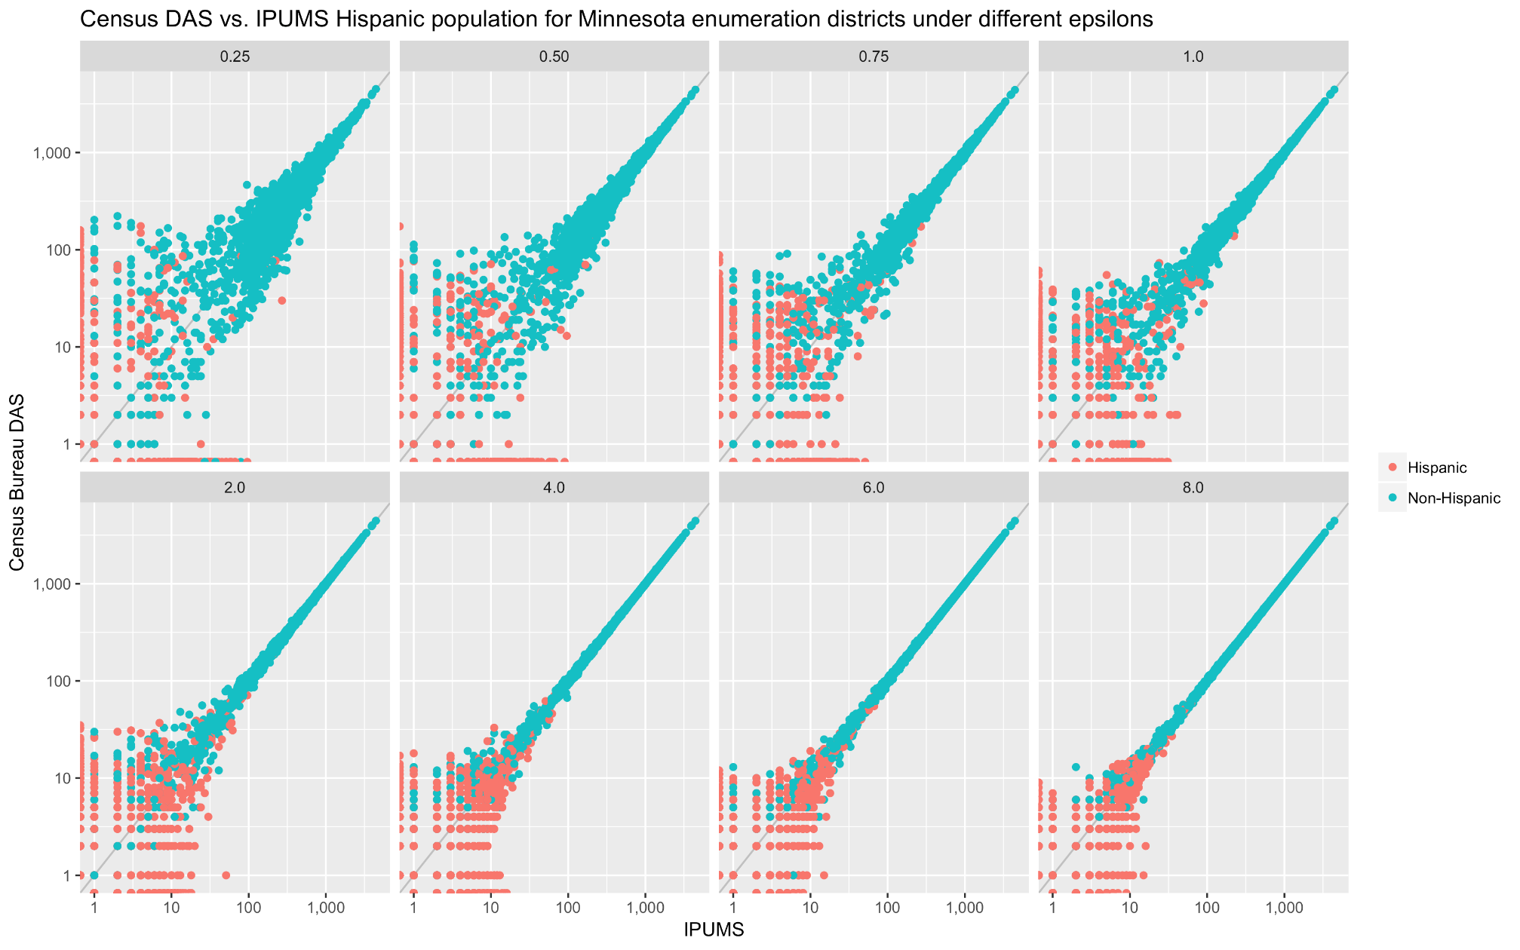
Analysis of population variances David Van Riper & Tracy Kugler, IPUMS (APDU 2019)
Notes:
This is the same kind of graph, but for enumeration districts, not for counties.
Here again we see eight versions of the same graph, from epsilon 0.25 to 8.0.
As you can see, the lower values of epsilon have both more randomness, but also more bias—the graph is not symmetrical around the line x=y. That’s because 0s are getting only rounded up, so larger values are being pushed lower more often than they would otherwise be.

Slide 33
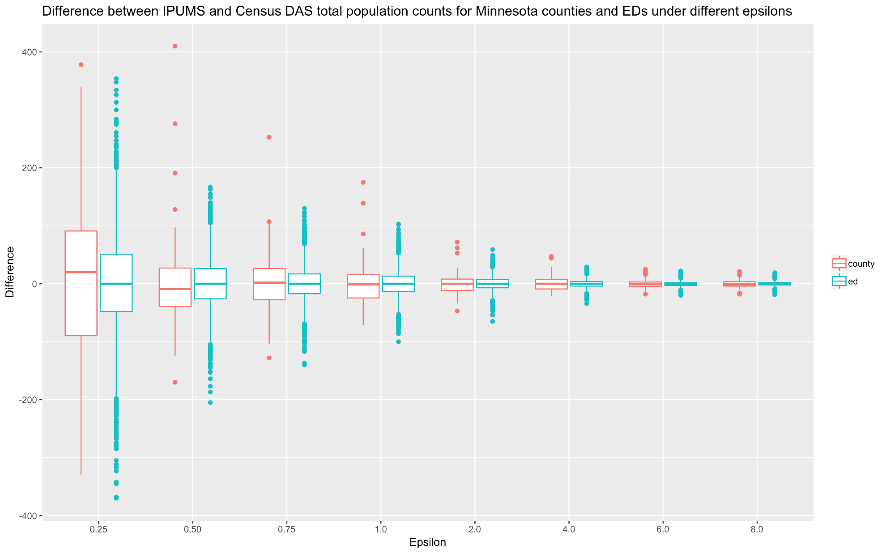
Analysis of population variances David Van Riper & Tracy Kugler, IPUMS (APDU 2019)
Notes:
This graph by Riper and Kugler looks at the distribution of those differences for different values of epsilon, from 0.25 to 8.0. This time brown shows counties and green shows enumeration districts. Again, you can see that there is more bias at small values of epsilon.

Slide 34
For more information…
Can a set of equations keep U.S. census data private?
By Jeffrey Mervis Science
Jan. 4, 2019 , 2:50 PM
Communications of ACM March 2019 Garfinkel & Abowd
http://bit.ly/Science2019C1

Slide 35
More Background on the 2020 Disclosure Avoidance System
September 14, 2017 CSAC (overall design) https://www2.census.gov/cac/sac/meetings/2017-09/garfinkel-modernizing-disclosure-avoidance.pdf
August, 2018 KDD’18 (top-down v. block-by-block) https://digitalcommons.ilr.cornell.edu/ldi/49/
October, 2018 WPES (implementation issues) https://arxiv.org/abs/1809.02201
October, 2018 ACMQueue (understanding database reconstruction) https://digitalcommons.ilr.cornell.edu/ldi/50/ or https://queue.acm.org/detail.cfm?id=3295691
Memorandum 2019.13: Disclosure Avoidance System Design Parameters https://www.census.gov/programs-surveys/decennial-census/2020-census/planning-management/memo-series/2020-memo-2019_13.html

